Slide 1
Data Structures

Slide 2
Data Structures
“A way to store and arrange data, in a way that suits an algorithm.”
Has a concrete implementation: we can calculate complexity of operations
Examples:
Arrays
Linked Lists
(Binary Search) Trees
Hash Maps
Heaps
Graphs

Slide 3
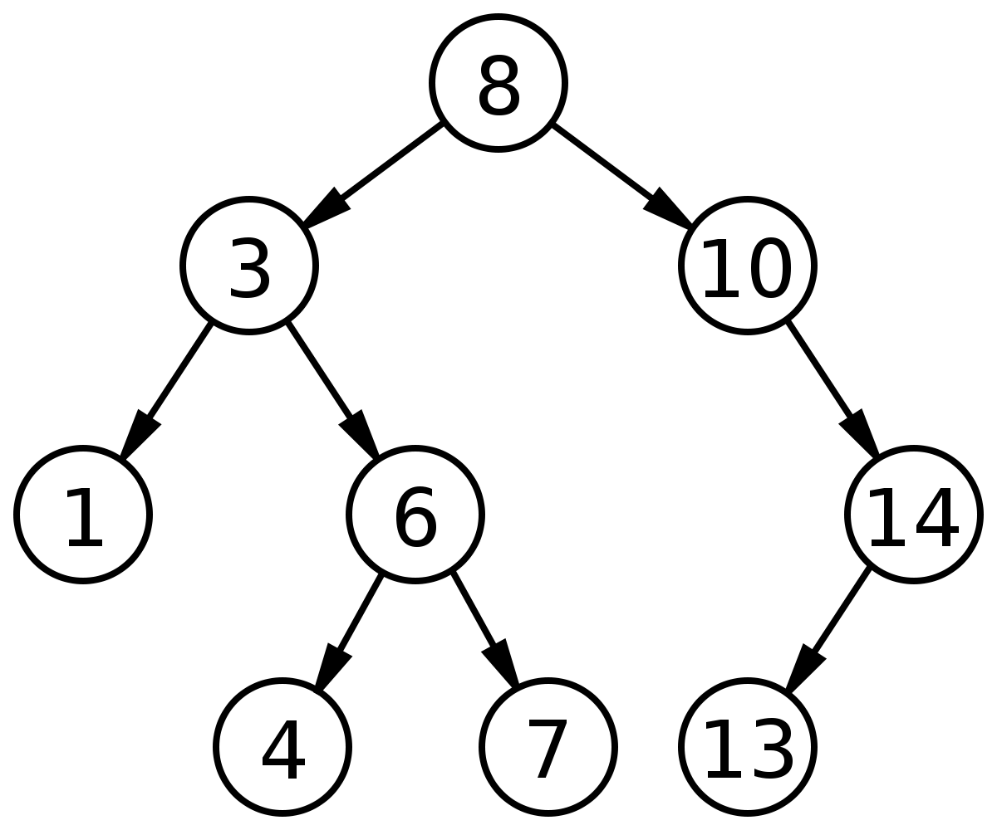
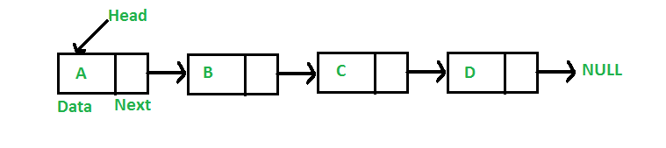

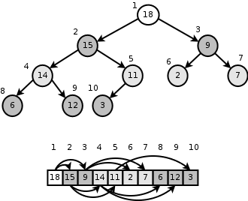
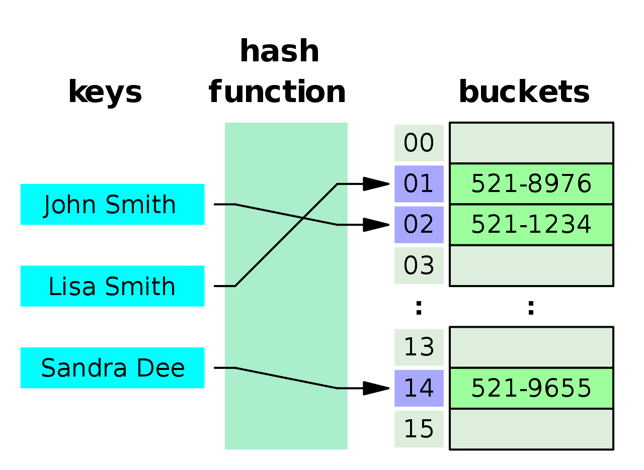
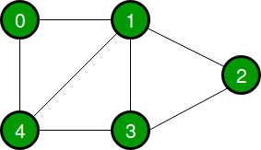
Linked Lists
1
Binary Search Trees
Arrays
Heaps
Undirected Cyclic Graph
Hash Maps

Slide 4
Abstract Data Types (ADTs)
“Collection of data items, family of operations that operate on data.”
Usually limited to a small set of defined operations. Can be implemented by a number of different concrete data structures.
But some might provide better performance / time complexity for the operations we want.
Examples: (usually implemented by)
List => array, linked list
Stacks => array, singly-linked list
Queues => singly / doubly linked list
Priority Queues => heap, binary search tree
Dictionary => hash map

Slide 5
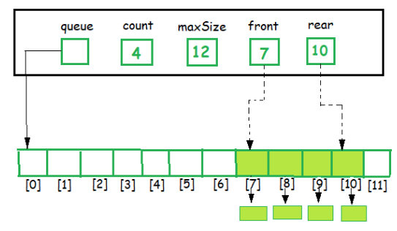
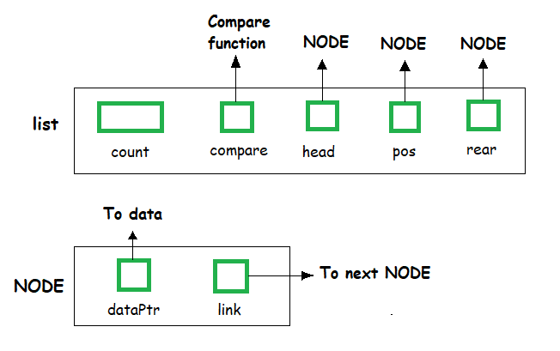
Lists (ADT)
create empty list
free/destroy the list
is empty?
add to start (head)
add to end of list
get first element of list (head)
get all but first element of the list ("tail")
get element at a specific index
Could be implemented by:
Arrays (variable length / dynamic)
Singly Linked List
Doubly Linked List
(GeeksForGeeks)

Slide 6
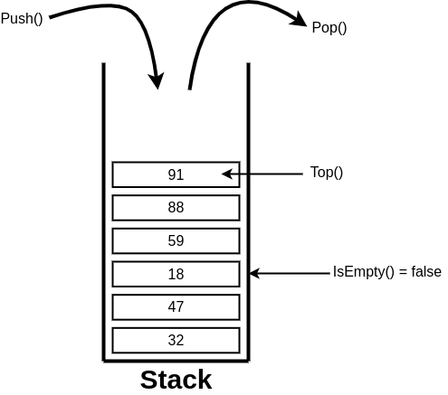
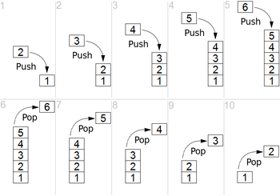
Stacks (ADT) LIFO: Last in First Out
create new
destroy / free
is empty?
push (add to top)
pop (remove from top)
top (get top element, but don't remove it)

Slide 7
Stack Example
stack_t stack = new_stack();
push(stack, 5);
push(stack, 6);
push(stack, 4);
pop(stack);
pop(stack);
push(stack, 1);
printf(“%d”, pop(stack));
free_stack(stack);

Slide 8
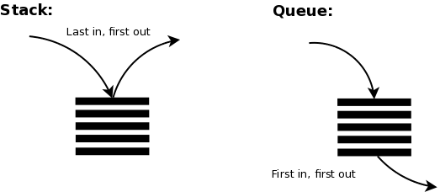
Stack Example
stack_t stack = new_stack();
push(stack, 5);
push(stack, 6);
push(stack, 4);
pop(stack);
pop(stack);
push(stack, 1);
printf(“%d”, pop(stack));
// 1
free_stack(stack);
// bottom -> {} <- top
// {5}
// {5, 6}
// {5, 6, 4}
// {5, 6} 4 popped
// {5} 6 popped
// {5, 1}
// {5} 1 popped

Slide 9
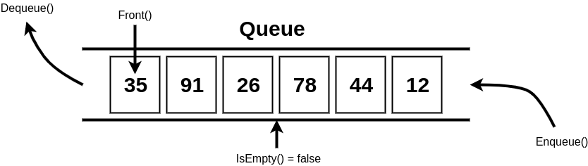
Queues (ADT) FIFO: First in First Out
create new
destroy / free
is empty?
enqueue (add to end of queue)
dequeue (remove from front of queue)
front (get front, without removing it)

Slide 10
Queue Example
queue_t queue = new_queue();
enqueue(queue, 5);
enqueue(queue, 6);
enqueue(queue, 4);
dequeue(queue);
dequeue(queue);
enqueue(queue, 1);
printf(“%d”, dequeue(queue));
free_queue(queue);

Slide 11
Queue Example
queue_t queue = new_queue();
enqueue(queue, 5);
enqueue(queue, 6);
enqueue(queue, 4);
dequeue(queue);
dequeue(queue);
enqueue(queue, 1);
printf(“%d”, dequeue(queue));
// 4
free_queue(queue);
// front -> {} <- back
// {5}
// {5, 6}
// {5, 6, 4}
// {6, 4} 5 popped
// {4} 6 popped
// {4, 1}
// {1} 4 popped

Slide 12
Data Structures (Summary)
Data structures (DSs)
: Implementation ("C")
Calculate time complexity of operations
Array
Linked List
Trees
Hashmap
Heap
Abstract data types (ADTs)
: Idea ("python")
Time complexity of operations depends on data structure used to implement it
List
Stack
Queue
Dictionary
Priority Queue

Slide 13
Binary Search Trees

Slide 14
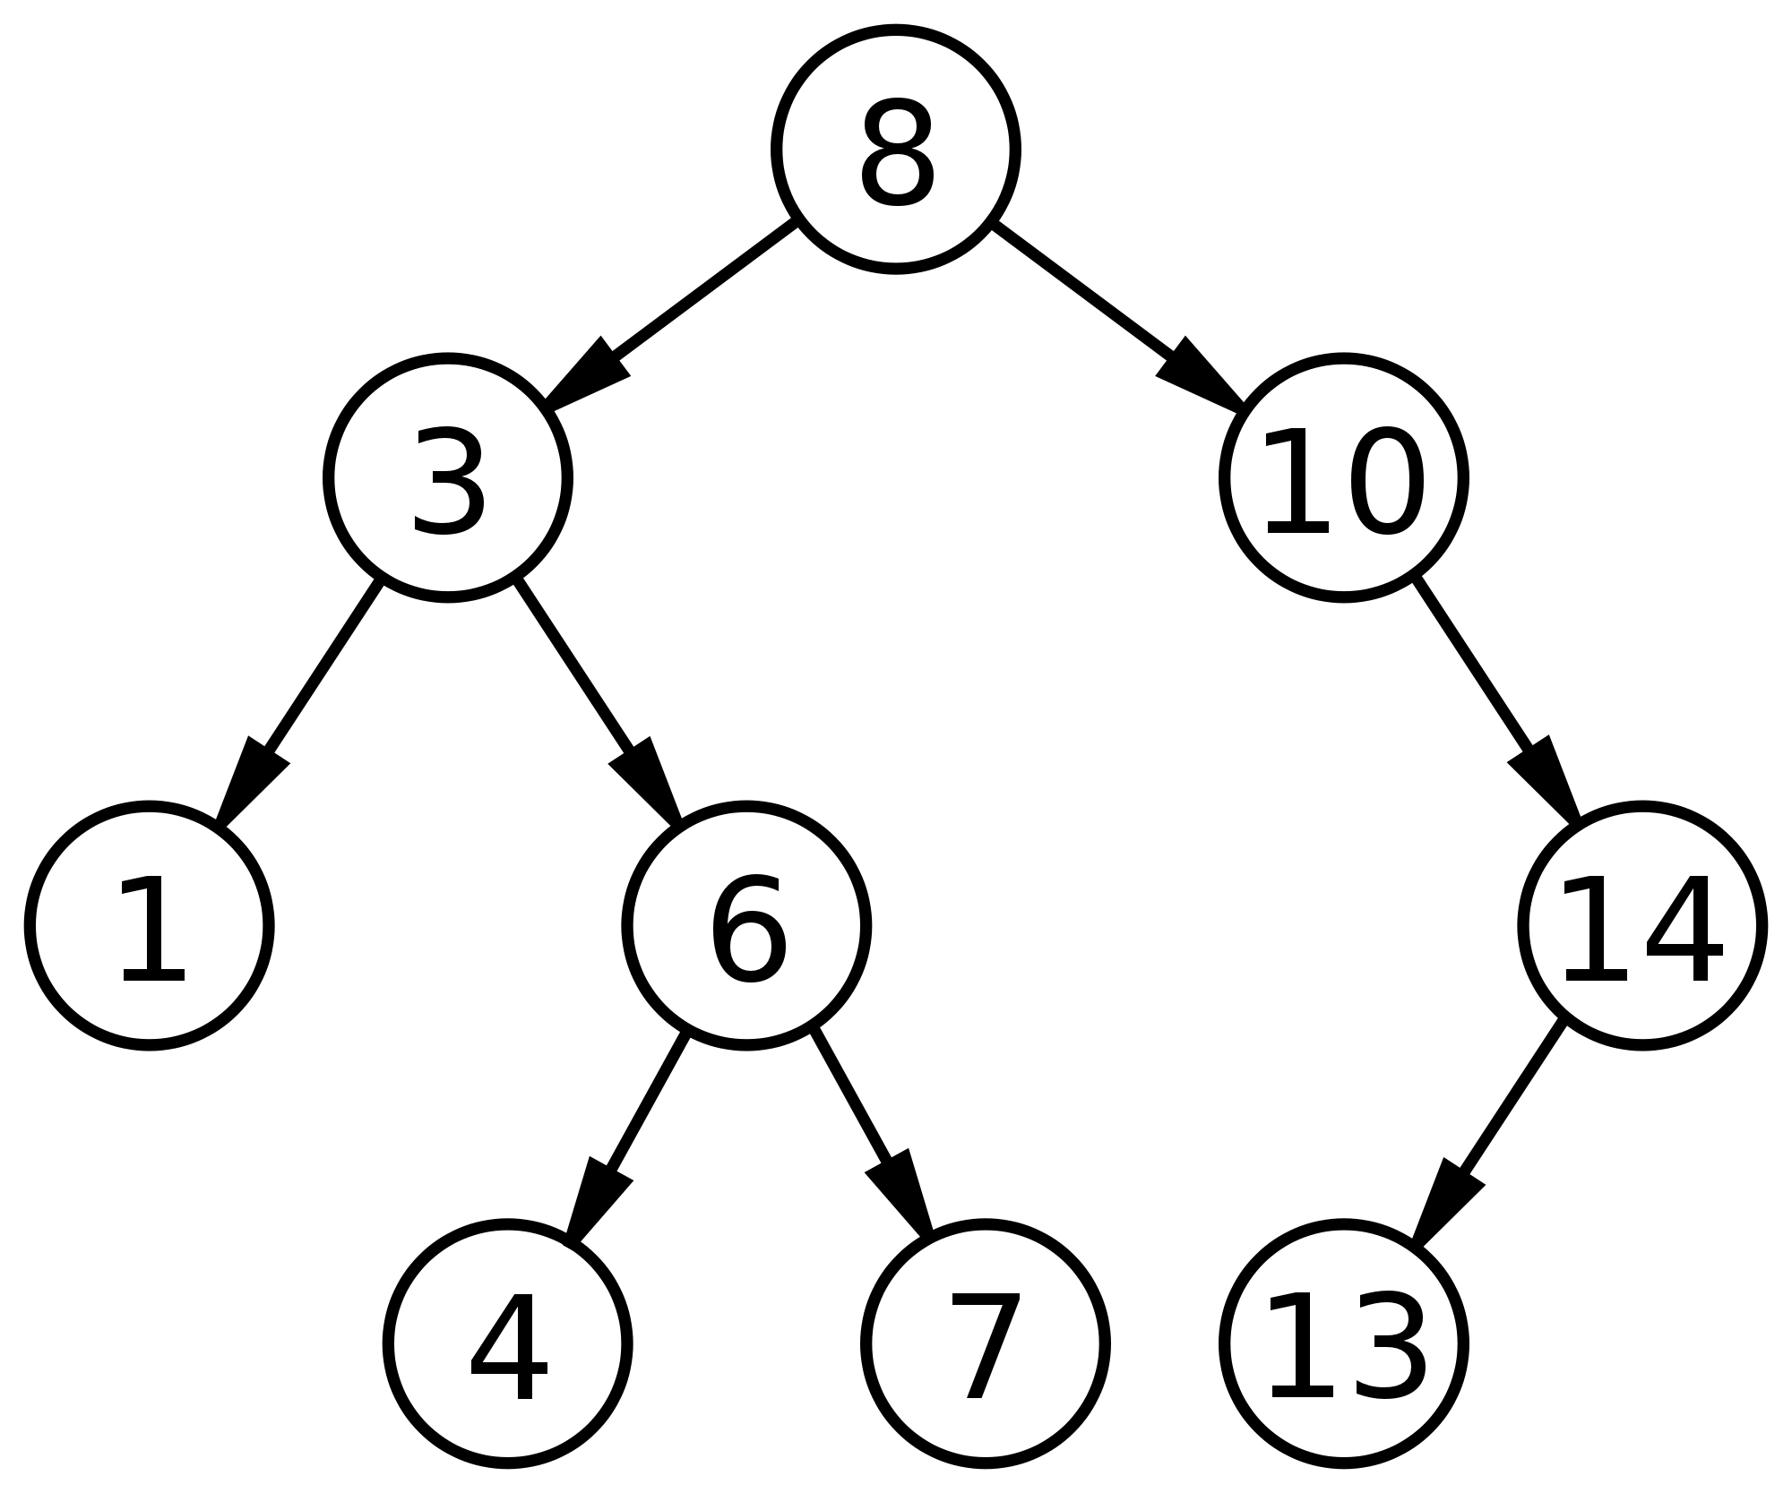
Binary Search Tree
Non-Linear data structure
Binary tree: each node has up to two child nodes.
Nodes are linked together using pointers (again)
Structure keeps elements in sorted order, can always binary search.
typedef struct node node_t;
struct node {
void *data; // polymorphic
node_t *left;
node_t *right;
};
typedef struct {
node_t *root;
int (*cmp)(void*,void*);
} tree_t;
cmp: arg1 is new item arg2 is item in tree

Slide 15
Binary Search Trees
Useful for fast/insert/delete on sorted data.
NOT the same as binary search on sorted array! -> O(log n) search!
Operation | Average / best case (balanced) | Worst case (stick)
Insert (ordered) | O(log n) | O(n)
Delete | O(log n) | O(n)
Search | O(log n) | O(n)
Design of Algorithms: Self-balancing binary trees red-black, 2-3, B-trees, AVL trees ...
https://en.wikipedia.org/wiki/Self-balancing_binary_search_tree O(log n) avg case!
Hashmaps: O(1) average for insert, search, delete!

Slide 16
Arrays

Slide 17
Arrays, as a data structure
Linear data structure -- items stored one after another
Elements stored in contiguous memory locations.
In storing data, we have operations we want / need to perform. For an array, what’s the complexity of these operations?
Insert at front:
Insert at end:
Insert at random position:
Delete at front:
Delete at end:
Delete at random position:
Search for a value:
1 | 6 | 9 | 4 | 5 | 7

Slide 18
Arrays, as a data structure
Linear data structure -- items stored one after another
Elements stored in contiguous memory locations.
In storing data, we have operations we want / need to perform. For an array, what’s the complexity of these operations?
Insert at front: O(n) -- need to shift each element 1 over
Insert at end: O(1), if there’s room; otherwise O(n) to resize!
Insert at random position: O(n) -- need to shift
Delete at front: O(n) -- need to shift each element 1 back!
Delete at end: O(1)
Delete at random position: O(n) -- need to shift each element 1 back
Search for a value: O(n) unsorted (linear), O(log n) sorted (binary)
1 | 6 | 9 | 4 | 5 | 7

Slide 19
Linked List

Slide 20
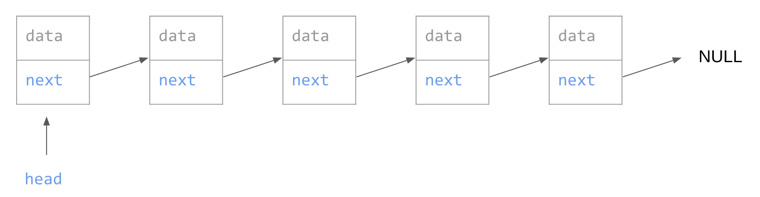
Linked List
Linear data structure
Elements not stored in contiguous memory locations
Elements are linked together using pointers
typedef int data_t;
typedef struct node node_t;
struct node {
data_t data;
node_t *next;
};
node_t *head = malloc(sizeof(node_t));
head->data = value;
head->next = NULL;

Slide 21
Linked List Operations
Insert at head
Remove at head
Insert at tail
Remove at tail
Draw it
Next slides for review.
head = front = start
foot = end = tail
Note: if you are examined on coding this up, the question will guide you. Just understand the concepts and complexities!
You’ll learn more about data structures and ADTs in COMP20007 Design of Algorithms.

Slide 22
Insert at head list_t *insert_at_head(list_t *list, data_t value)
node_t *newhead = malloc(sizeof(node_t));
assert(newhead);
newhead->data = value;
...
data
next
newhead
data
next
data
next
data
next
data
next
data
next
NULL
head

Slide 23
Insert at head list_t *insert_at_head(list_t *list, data_t value)
node_t *newhead = malloc(sizeof(node_t));
assert(newhead);
newhead->data = value;
newhead->next = head;
head = newhead;
// forget about newhead - can use the variable again
data
next
head
data
next
data
next
data
next
data
next
data
next
NULL

Slide 24
Remove at head
free(head);
data
next
head
data
next
data
next
data
next
data
next
data
next
NULL

Slide 25
Remove at head
free(head);
There’s no pointer to the new head!
data
next
data
next
data
next
data
next
data
next
NULL

Slide 26
Remove at head
node_t *oldhead = head;
head = oldhead>next;
free(oldhead);
// oldhead = NULL;
data
next
data
next
data
next
data
next
data
next
NULL
head

Slide 27
Insert at tail
node_t *newtail- = malloc(sizeof(node_t));
newtail->data = value;
...
data
next
newtail
data
next
data
next
data
next
data
next
data
next
NULL
head

Slide 28
Linked list traversal (To tail)
node_t *p = head;
assert(p); // null->next is illegal
while (p->next) {
p = p->next;
}
// p points to the tail.
Works with
head-tail and
doubly as well.
data
next
data
next
data
next
data
next
data
next
NULL
head

Slide 29
Insert at tail
node_t *newtail = malloc(sizeof(node_t));
newtail>data = value;
newtail->next = NULL;
// get tail from iteration, or data structure
tail->next = newtail;
tail = newtail;
data
next
newtail
data
next
data
next
data
next
data
next
data
next
NULL
head
tail

Slide 30
Insert at tail
node_t *newtail = malloc(sizeof(node_t));
newtail>data = value;
newtail->next = NULL;
// get tail from iteration, or data structure
tail->next = newtail;
tail = newtail;
data
next
newtail
NULL
tail
data
next
data
next
data
next
data
next
data
next
head

Slide 31
Remove at tail
free(tail)?
data
next
data
next
data
next
data
next
data
next
NULL
head
tail

Slide 32

Remove at tail
free(tail);
Need to set second_last->next = NULL;
=> will be O(n) using a singly linked list.
data
next
data
next
data
next
data
next
(garbage)
(it has a garbage collector)
head

Slide 33
Remove at tail
prev
data
next
prev
data
next
prev
data
next
prev
data
next
prev
data
next
NULL
NULL
head
tail

Slide 34
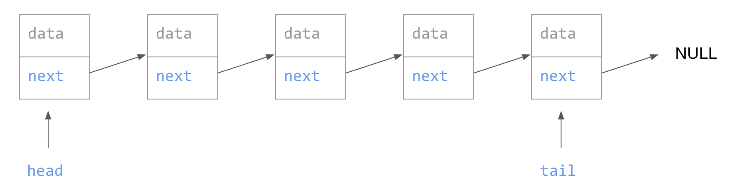
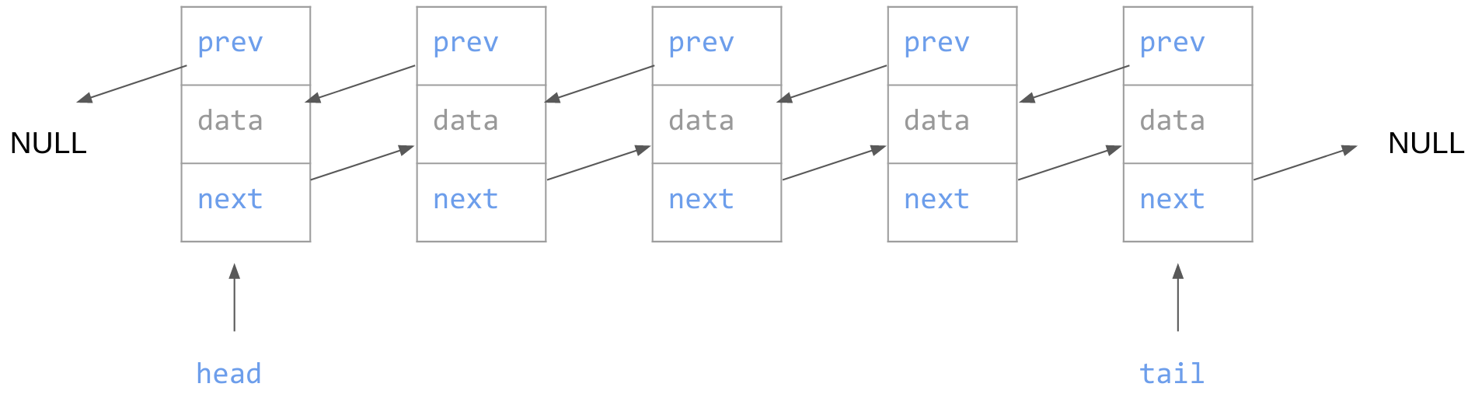
Linked List types
Singly Linked List (Head only)
Singly Linked List (Head & Tail)
Doubly Linked List

Slide 35
Linked List types
Operation | Array | Singly head | Singly head/tail | Doubly
Insert at head | O(n) | O(1) | O(1) | O(1)
Delete at head | O(n) | O(1) | O(1) | O(1)
Insert at tail | O(1) or O(n) [resize] | O(n) | O(1) | O(1)
Delete at tail | O(1) | O(n) | O(n) | O(1)
Search for data | O(n) unsorted O(log n) sorted | O(n) avg/worst | O(n) avg/worst | O(n) avg/worst
space | n * sizeof(data) + 4 (store length) | n x sizeof(data) + 8(n+1) | n x sizeof(data) + 8(n+2) | n x sizeof(data) + 8(2n+2)
200 ints (size=4) | 804 | 2048 | 2416 | 4016

Slide 36
Linked List (Singly, head only)
Operation | Complexity
Insert at head | O(1)
Delete at head | O(1)
Insert at tail | O(n)
Delete at tail | O(n)
Search for data | O(1) best O(n) avg/worst
typedef int data_t;
typedef struct node node_t;
struct node {
data_t data;
node_t *next;
};
typedef node_t list_t; // “head”
Space: n x sizeof(data)
+ 8 x n (next pointers)
+ 8 (head pointer)
= n x sizeof(data) + 8(n+1)
Can we improve?

Slide 37
Linked List (Singly, head & tail)
Operation | Complexity
Insert at head | O(1)
Delete at head | O(1)
Insert at tail | O(1)
Delete at tail | O(n)
Search for data | O(1) best O(n) avg/worst
typedef int data_t;
typedef struct node node_t;
struct node {
data_t data;
node_t *next;
};
typedef struct {
node_t *head;
node_t *tail;
} list_t;
Space: n x sizeof(data)
+ 8 x n (next pointers)
+ 8 x 2 (head, tail)
= n x sizeof(data) + 8(n+2)
Can we improve?

Slide 38
Doubly Linked List
Operation | Complexity
Insert at head | O(1)
Delete at head | O(1)
Insert at tail | O(1)
Delete at tail | O(1)
Search for data | O(1) best O(n) avg/worst
typedef int data_t;
typedef struct node node_t;
struct node {
data_t data;
node_t *prev;
node_t *next;
};
typedef struct {
node_t *head;
node_t *tail;
} list_t;
Space: n x sizeof(data)
+ 8 x n x 2 (next, prev)
+ 8 x 2 (head, tail)
= n x sizeof(data) + 8(2n+2)
200 ints = 200x4 + 8x402 = 4016
Array of 200 ints: 200x4 = 800

Slide 39
If the space complexity is so bad, why use it?
Space: n x sizeof(data)
+ 8 x n x 2 (next, prev)
+ 8 x 2 (head, tail)
= n x sizeof(data) + 8(2n+2)
200 ints = 200x4 + 8x402 = 4016
Array of 200 ints: 200x4 = 800
200 structs, sizeof(struct) = 5120 B (5 KB)
Linked list: 200x5120 + 8x402 = 1027216 B (~0.980 MB)
Array: 200x5120 = 1024000 B (~0.977 MB)

Slide 40
Searching Linked Lists
How to access the n/2th element?

Slide 41
Searching Linked Lists
O(n) (ac, wc) for:
Searching for an item in list
Accessing / adding / replacing / removing item at random index
How to access the n/2th element?
No random access in linked lists.
Array: A[n/2].

Slide 42
Linked list traversal (To kth element)
node_t *p = head;
assert(p); // null->next is illegal
int i = 0;
while (p && i++ != k) {
p = p->next;
}
// p points to kth element (i - 1th element)
return p;
Works with
head-tail and
doubly as well.
O(n)
data
next
data
next
data
next
data
next
data
next
NULL
head

Slide 43
Linked list search
node_t *p = head;
assert(p); // null->next is illegal
int i = 0;
while (p && p->data != target) {
p = p->next;
}
// p points to target, or NULL.
return p;
Works with
head-tail and
doubly as well.
O(n)
data
next
data
next
data
next
data
next
data
next
NULL
head

Slide 44
Linked Lists vs Arrays Summary
Use arrays for:
Randomly accessing items
Binary search
Quicksort
Fast iteration
Use Linked Lists for:
Adding lists together
Adding / removing items from start / end
Mergesort

Slide 45
 | Array | Linked List (singly) | Doubly
Insert at head | O(n) -- shifting | O(1) -- add at head
Insert at tail | O(1) -- append O(n) sometimes (realloc) | O(n) -- need to traverse list to end (singly, head only) O(1) -- add at tail (singly, head & tail; or doubly)
Insert random | O(n) -- shifting | O(n) -- no random access, traverse the list
Delete at head | O(n) -- shifting | O(1) -- delete head
Delete at tail | O(1) | O(n) -- need to update 2nd last element’s next | O(1) -- update tail.prev
Delete random | O(n) -- shifting | O(n) -- no random access, traverse the list
Replace / Access random | O(1) -- A[i] = x | O(n) -- no random access, traverse the list
Search | O(n) linear (unsorted) O(log n) binary (sorted) | O(n) - can only search linearly
Memory s = sizeof(data) | Less n x s | More n x s + 8 (n + (1 or 2)) | Morer n x s + 8 (2n + 2)
Use for | Random access Fast sorted search | Fast insert/delete at head and tail No random access

Slide 46
Stacks & Queues: Implementation

Slide 47
Stack
Last in, First out (LIFO)
push(data) -- add to top of stack
pop() -- remove from top of stack
push(d)
d = pop()

Slide 48
Queue
First in, First out (FIFO)
enqueue(data) -- add to back of queue
dequeue() -- remove from front of queue
enqueue(d)
d = dequeue()

Slide 49
Stacks & Queues
Stack
Last in, First out (LIFO)
push(data) -- add to top of stack
pop() -- remove from top of stack
Queue
First in, First out (FIFO)
enqueue(data) -- add to back of queue
dequeue() -- remove from front of queue
How to implement these ADTs with a data structure?
It would be nice to have these as O(1) operations.
push(d)
d = pop()
enqueue(d)
d = dequeue()

Slide 50
Stack Implementation
Stack
Last in, First out (LIFO)
push(data) -- add to top of stack
pop() -- remove from top of stack
Which data structure gives optimal time complexity?
 | Array | Linked List; head only | head & tail | doubly
Insert at head | O(n) -- shifting | O(1) -- traverse head
Insert at tail | O(1) -- append O(n) sometimes | O(n) -- no tail pointer, need to traverse list. | O(1) -- traverse tail
Delete at head | O(n) -- shifting | O(1) -- traverse head
Delete at tail | O(1) | O(n) -- need to update 2nd last element’s next |  | O(1) -- tail.prev
Memory (ints) | Best | Worse | Worser | Worst

Slide 51
Stack Implementation
Stack
Last in, First out (LIFO)
push(data) -- add to top of stack (insert at head)
pop() -- remove from top of stack (delete at head)
 | Array | Linked List; head only | head & tail | doubly
Insert at head | O(n) -- shifting | O(1) -- traverse head
Insert at tail | O(1) -- append O(n) sometimes | O(n) -- no tail pointer, need to traverse list. | O(1) -- traverse tail
Delete at head | O(n) -- shifting | O(1) -- traverse head
Delete at tail | O(1) | O(n) -- need to update 2nd last element’s next |  | O(1) -- tail.prev
Memory (ints) | Best | Worse | Worser | Worst

Slide 52
Stack Implementation
Stack
Last in, First out (LIFO)
push(data) -- add to top of stack
pop() -- remove from top of stack
Arrays are fine for stacks of constant / maximum size
 | Array | Linked List; head only | head & tail | doubly
Insert at head | O(n) -- shifting | O(1) -- traverse head
Insert at tail | O(1) -- append O(n) sometimes | O(n) -- no tail pointer, need to traverse list. | O(1) -- traverse tail
Delete at head | O(n) -- shifting | O(1) -- traverse head
Delete at tail | O(1) | O(n) -- need to update 2nd last element’s next |  | O(1) -- tail.prev
Memory (ints) | Best | Worse | Worser | Worst

Slide 53
Queue Implementation
Queue
First in, First out (FIFO)
enqueue(data) -- add to back of queue
dequeue() -- remove from front of queue
Which to use?
 | Array | Linked List; head only | head & tail | doubly
Insert at head | O(n) -- shifting | O(1) -- traverse head
Insert at tail | O(1) -- append O(n) sometimes | O(n) -- no tail pointer, need to traverse list. | O(1) -- traverse tail
Delete at head | O(n) -- shifting | O(1) -- traverse head
Delete at tail | O(1) | O(n) -- need to update 2nd last element’s next |  | O(1) -- tail.prev
Memory (ints) | Best | Worse | Worser | Worst

Slide 54
Queue Implementation
Queue
First in, First out (FIFO)
enqueue(data) -- add to back of queue (front of list)
dequeue() -- remove from front of queue (back of list)
 | Array | Linked List; head only | head & tail | doubly
Insert at head | O(n) -- shifting | O(1) -- traverse head
Insert at tail | O(1) -- append O(n) sometimes | O(n) -- no tail pointer, need to traverse list. | O(1) -- traverse tail
Delete at head | O(n) -- shifting | O(1) -- traverse head
Delete at tail | O(1) | O(n) -- need to update 2nd last element’s next |  | O(1) -- tail.prev
Memory (ints) | Best | Worse | Worser | Worst

Slide 55
Queue Implementation
Queue
First in, First out (FIFO)
enqueue(data) -- add to back of queue (back of list)
dequeue() -- remove from front of queue (front of list)
 | Array | Linked List; head only | head & tail | doubly
Insert at head | O(n) -- shifting | O(1) -- traverse head
Insert at tail | O(1) -- append O(n) sometimes | O(n) -- no tail pointer, need to traverse list. | O(1) -- traverse tail
Delete at head | O(n) -- shifting | O(1) -- traverse head
Delete at tail | O(1) | O(n) -- need to update 2nd last element’s next |  | O(1) -- tail.prev
Memory (ints) | Best | Worse | Worser | Worst

